Slide 1
Logging

Slide 2
What is Logging
Logging is a means of tracking events that happen when some software runs.
The software’s developer adds logging calls to their code to indicate that certain events have occurred.
An event is described by a descriptive message which can optionally contain variable data.

Slide 3
Convenience Function
debug(), info(), warning(), error() and critical().
Task you want to perform | The best tool for the task
Display console output for ordinary usage of a command line script or program | print()
Report events that occur during normal operation of a program (e.g. for status monitoring or fault investigation) | logging.info() (or logging.debug() for very detailed output for diagnostic purposes)

Slide 4
Task you want to perform | The best tool for the task
Issue a warning regarding a particular runtime event | warnings.warn() in library code if the issue is avoidable and the client application should be modified to eliminate the warning logging.warning() if there is nothing the client application can do about the situation, but the event should still be noted
Report an error regarding a particular runtime event | Raise an exception
Report suppression of an error without raising an exception (e.g. error handler in a long-running server process) | logging.error(), logging.exception() or logging.critical() as appropriate for the specific error and application domain

Slide 5
Level or severity of the events
Level | When it’s used
DEBUG | Detailed information, typically of interest only when diagnosing problems.
INFO | Confirmation that things are working as expected.
WARNING | An indication that something unexpected happened, or indicative of some problem in the near future (e.g. ‘disk space low’). The software is still working as expected.
ERROR | Due to a more serious problem, the software has not been able to perform some function.
CRITICAL | A serious error, indicating that the program itself may be unable to continue running.

Slide 6
Example
import logging
logging.warning('Watch out!') # will print a message to the console
logging.info('I told you so') # will not print anything
Output:
WARNING:root:Watch out!

Slide 7
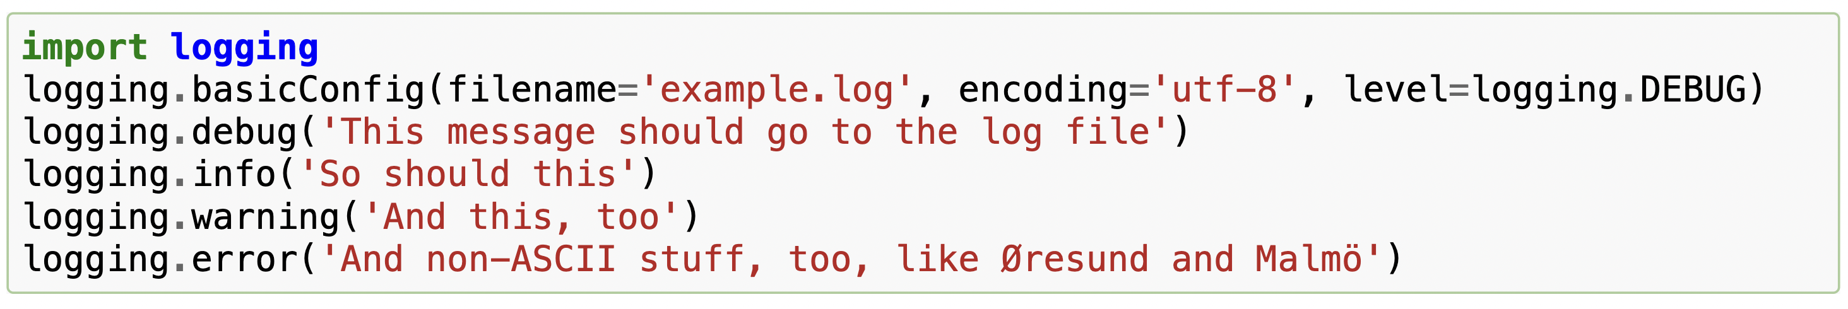
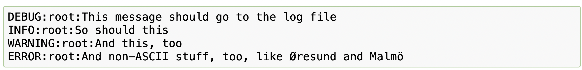
Logging to a file

Slide 8
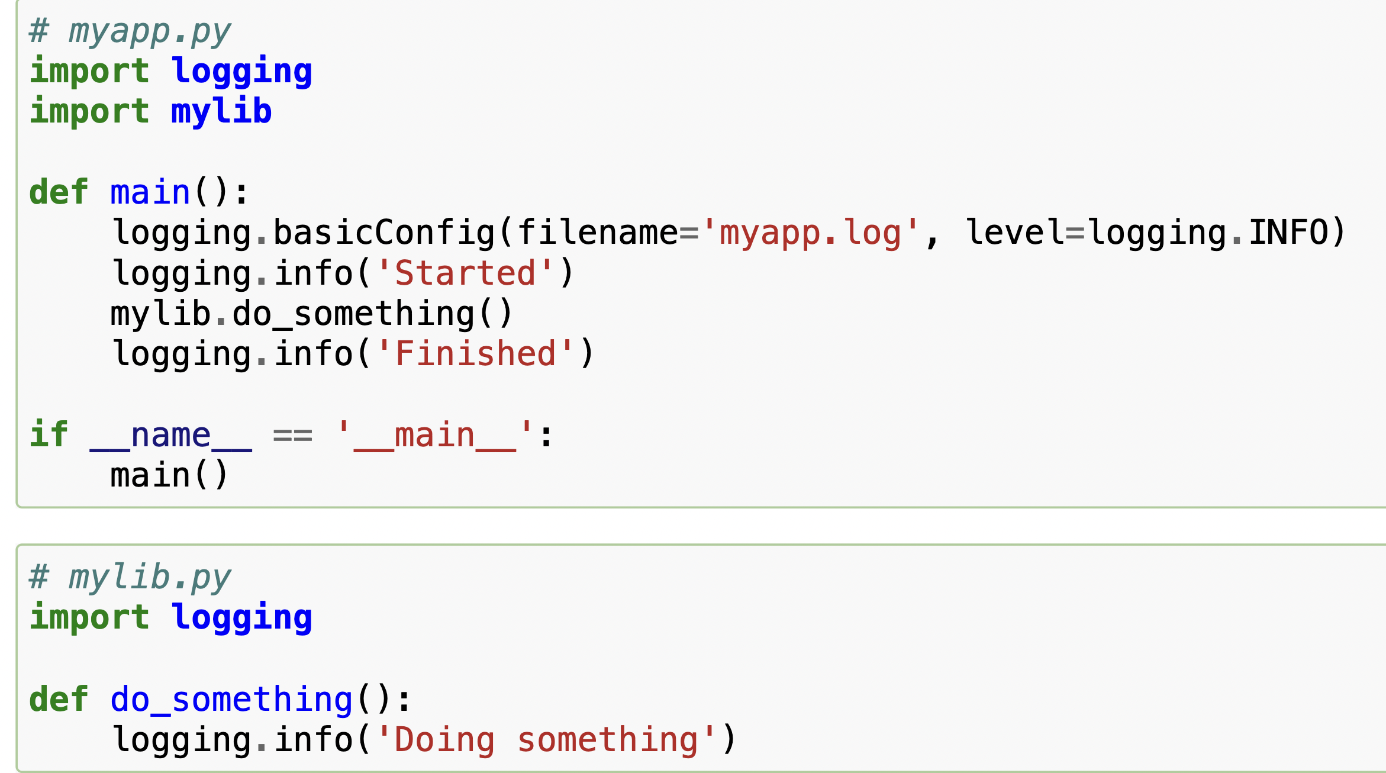
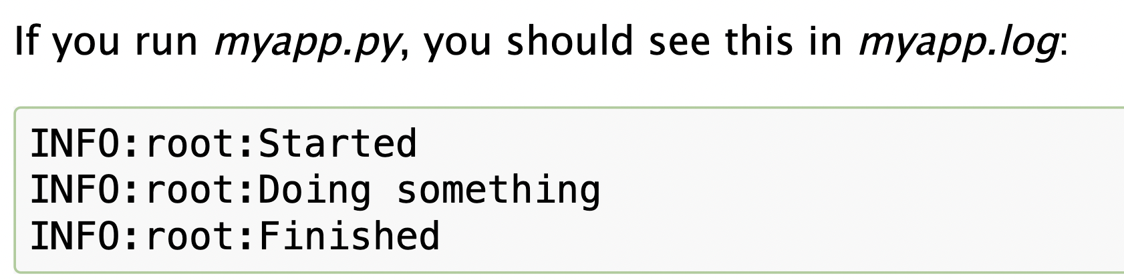
Example

Slide 9
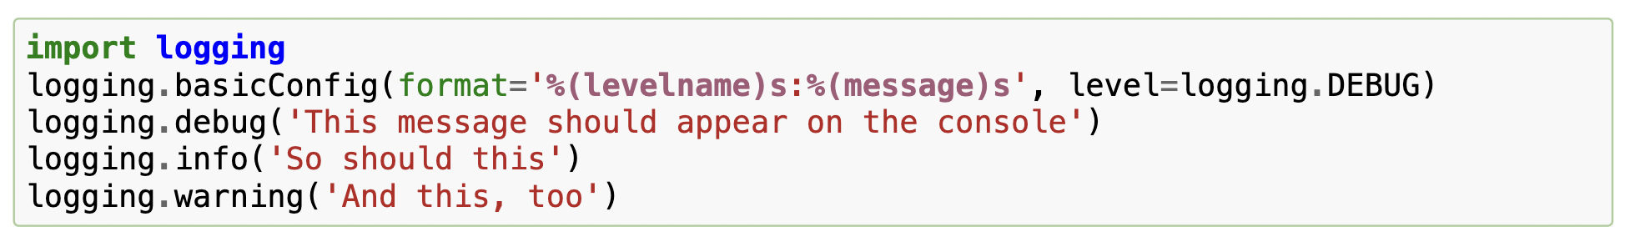
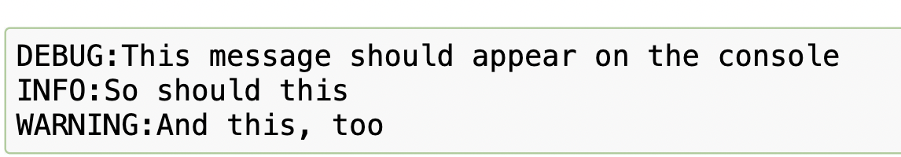
Changing the format of displayed messages

Slide 10
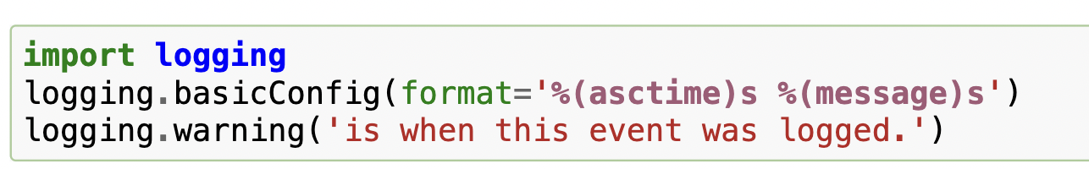
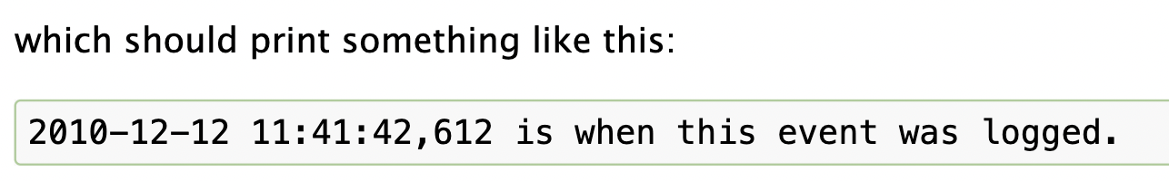
Date and time

Slide 11
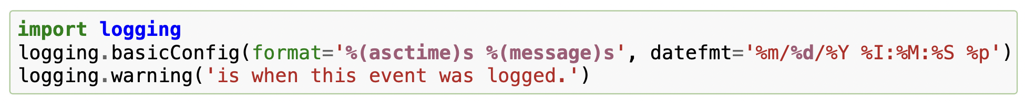
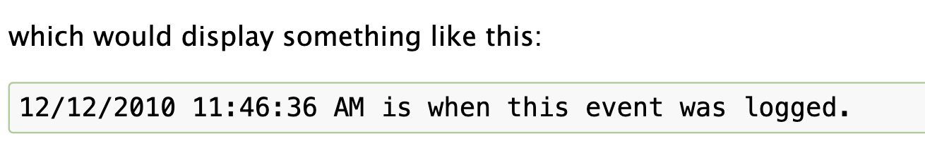
Date and time specific format

Slide 12
Task to do
You are developing a command-line task management system for a small team of users. The system should allow users to create tasks, assign them, update statuses, and track deadlines. Instead of using a database, you decide to store task data in text files.
User Management:
Implement a user registration system where users can sign up and log in. Store user data in a file, including usernames and hashed passwords.

Slide 13
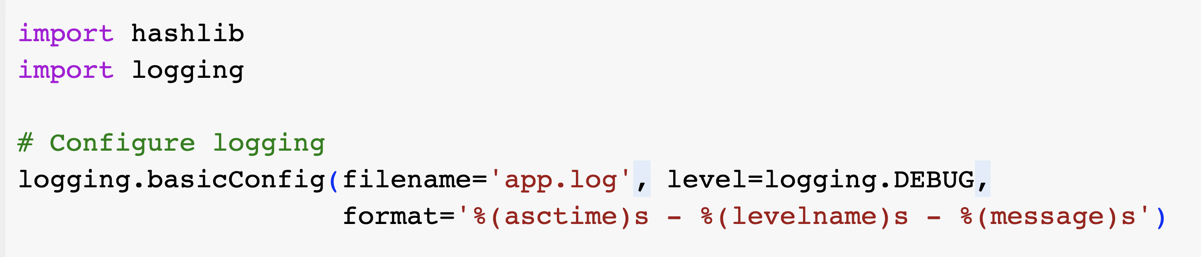

Slide 14
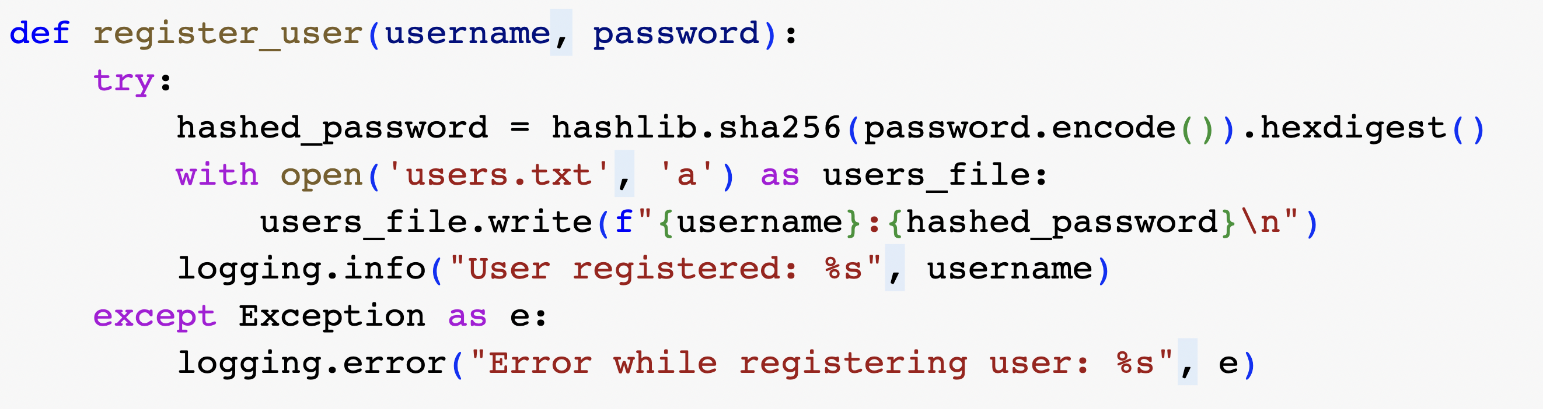

Slide 15
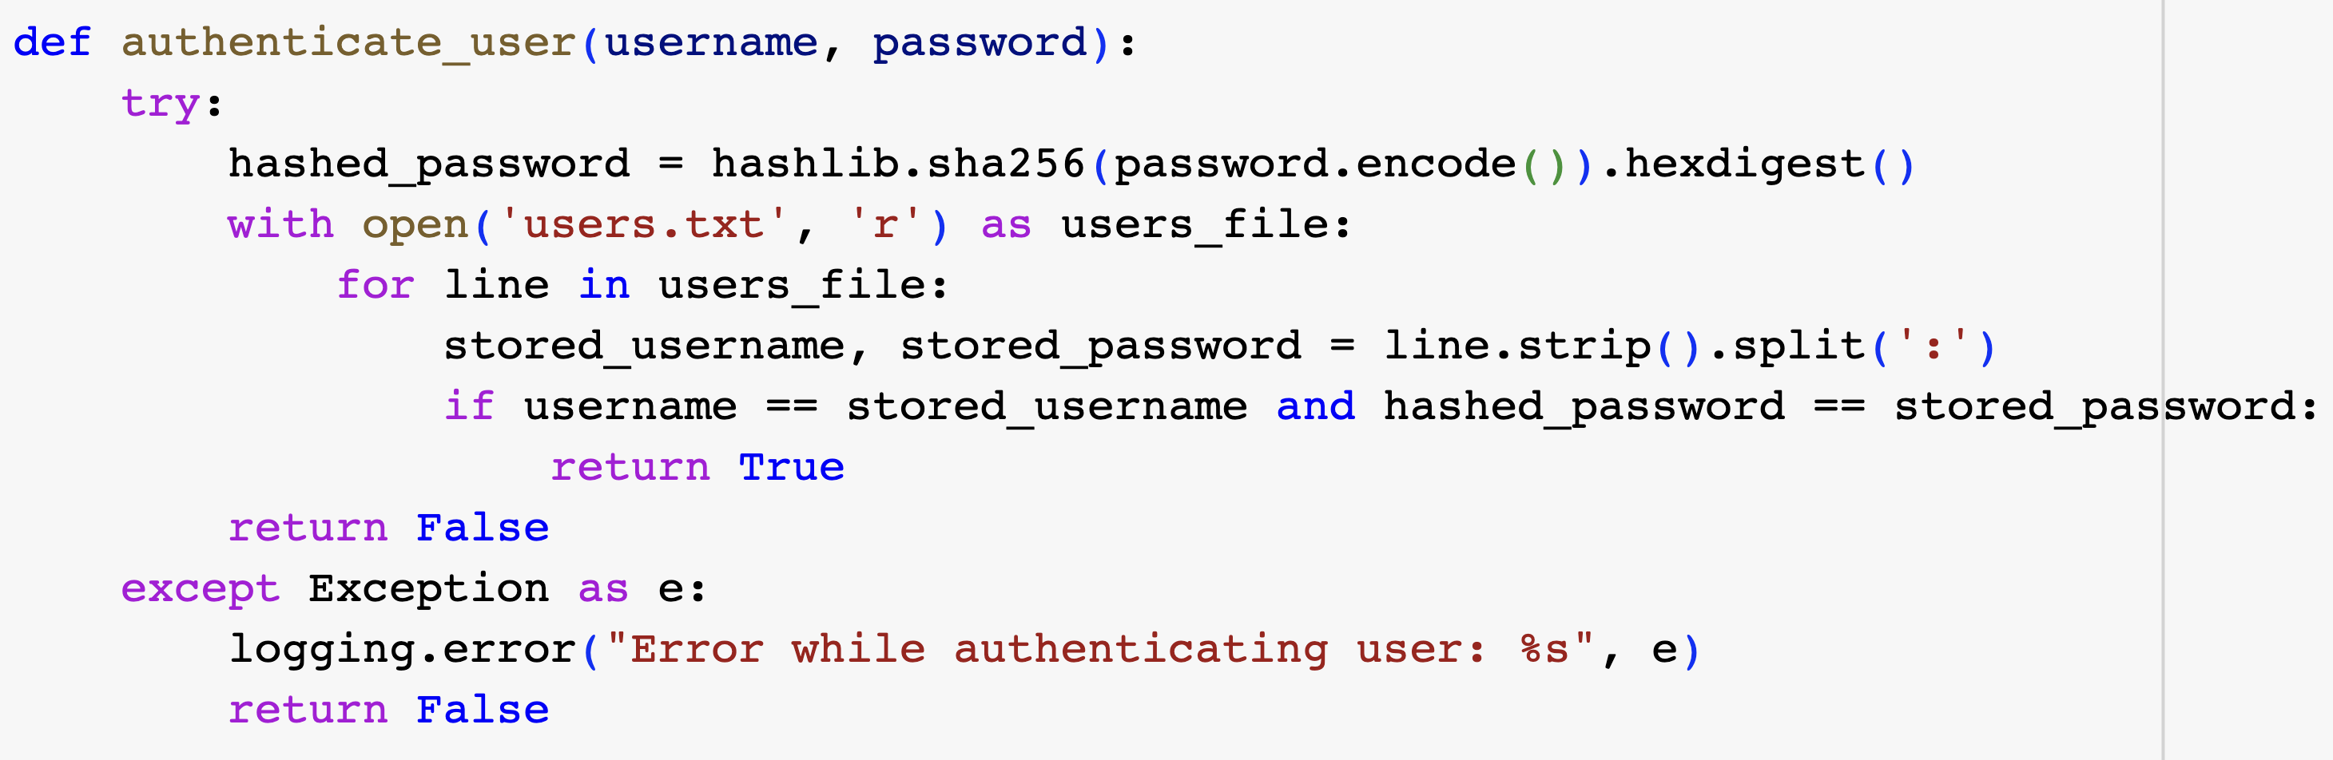

Slide 16
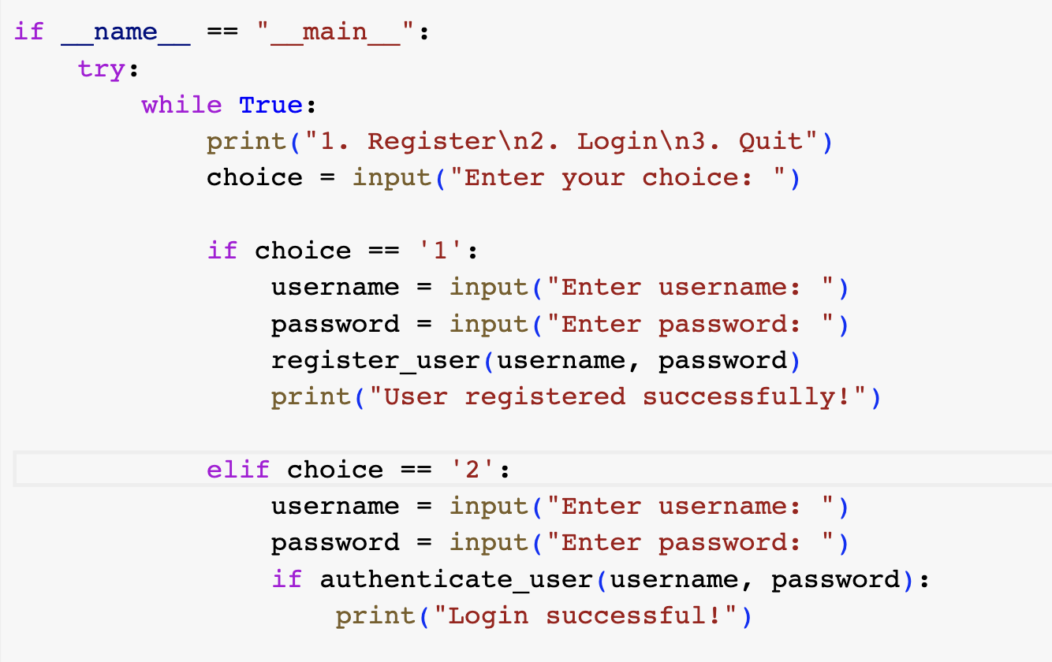

Slide 17
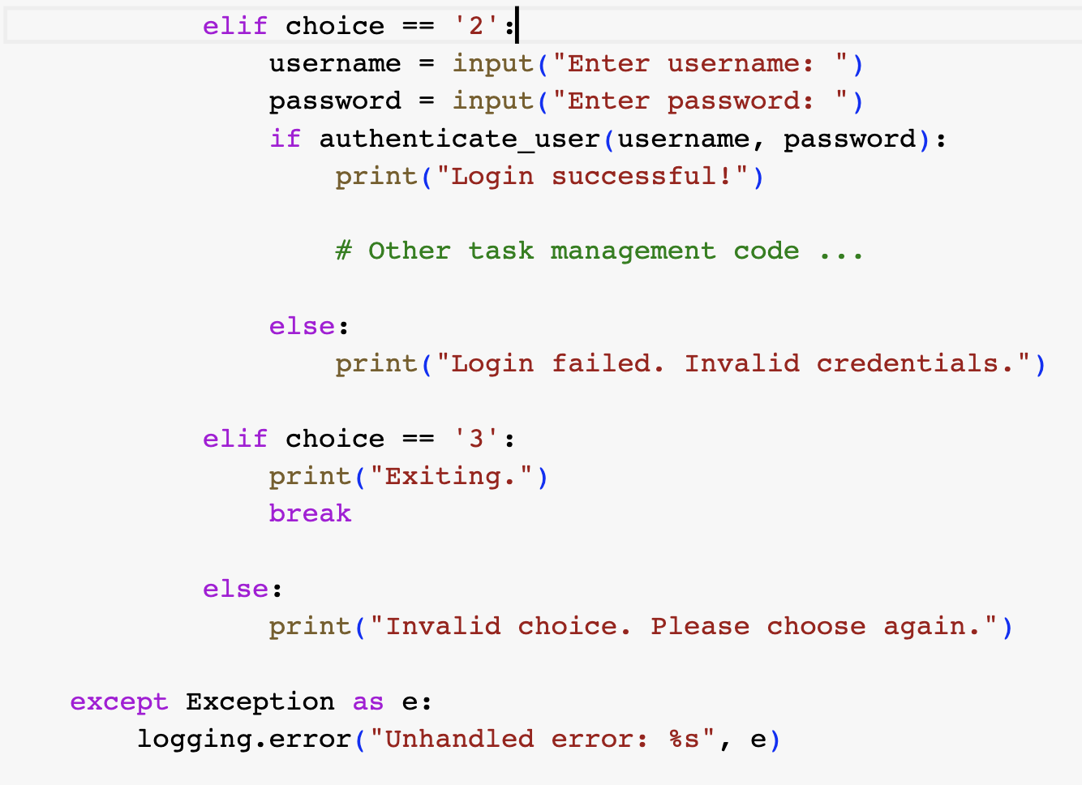

Slide 18
How logging works
The logging library takes a modular approach and offers several categories of components: loggers, handlers, filters, and formatters.
Loggers expose the interface that application code directly uses.
Handlers send the log records (created by loggers) to the appropriate destination.
Filters provide a finer grained facility for determining which log records to output.
Formatters specify the layout of log records in the final output.

Slide 19
Loggers
Logger objects have a threefold job.
First, they expose several methods to application code so that applications can log messages at runtime.
Second, logger objects determine which log messages to act upon based upon severity or filter objects.
Third, logger objects pass along relevant log messages to all interested log handlers.

Slide 20
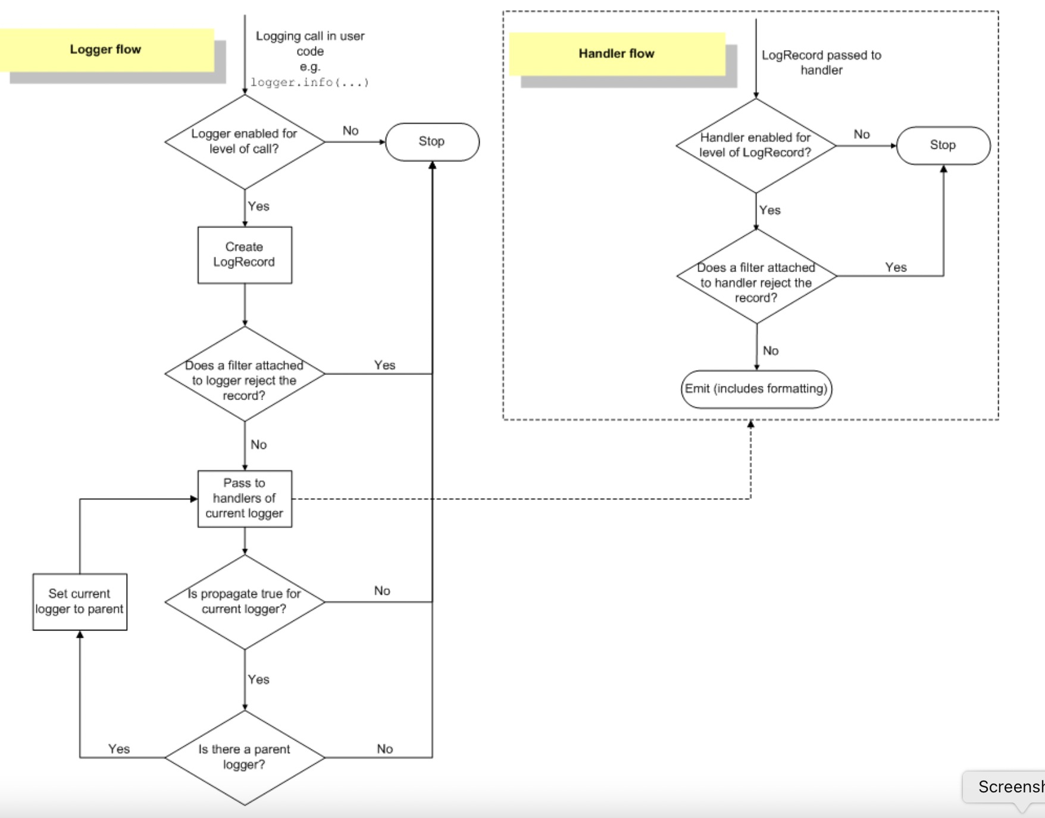

Slide 21
logger
logger objects fall into two categories
configuration
message sending.

Slide 22
Configuration
Logger.setLevel() specifies the lowest-severity log message a logger will handle.
Where debug is the lowest built-in severity level and critical is the highest built-in severity.

Slide 23
Configuaration
Logger.addHandler() and Logger.removeHandler() add and remove handler objects from the logger object. Handlers are covered in more detail in Handlers.
Logger.addFilter() and Logger.removeFilter() add and remove filter objects from the logger object. Filters are covered in more detail in Filter Objects.

Slide 24
Methods create log messages
Logger.debug(),
Logger.info(),
Logger.warning(),
Logger.error(),
Logger.critical() .

Slide 25
Log Message
Logger.exception() creates a log message similar to Logger.error().
The difference is that Logger.exception() dumps a stack trace along with it. Call this method only from an exception handler.
Creating custom log level
Logger.log() takes a log level as an explicit argument.

Slide 26
Logging Levels
Level | Numeric value
CRITICAL | 50
ERROR | 40
WARNING | 30
INFO | 20
DEBUG | 10
NOTSET | 0
These are primarily of interest if you want to define your own levels and need them to have specific values relative to the predefined levels.
If you define a level with the same numeric value, it overwrites the predefined value; the predefined name is lost.
it is possibly a very bad idea to define custom levels if you are developing a library. That’s because if multiple library authors all define their own custom levels, there is a chance that the logging output from such multiple libraries used together will be difficult for the using developer to control and/or interpret, because a given numeric value might mean different things for different libraries.

Slide 27
Handlers
Handler objects are responsible for dispatching the appropriate log messages (based on the log messages’ severity) to the handler’s specified destination.
As an example scenario, an application may want to send all log messages to a log file, all log messages of error or higher to stdout, and all messages of critical to an email address. This scenario requires three individual handlers where each handler is responsible for sending messages of a specific severity to a specific location.

